Slide 1


Java Truck Pilot Project
Using Data and K-Means Clustering to Profile Calgary Communities for a Mobile Coffee Vendor

Slide 2
Background
2020 has been a strange and turbulent year, and recent developments have seen metropolitan centres and their characteristic bustle hollowed out and hushed as business close their doors and employees transition to working remotely.
An entrepreneurial coffee artisan hopes to capitalize on these changes by taking their skillset on the road and adapting the tried and true ice cream truck business model to the world of craft coffee.
They have approached you to aid them in leveraging data to profile Calgary’s residential communities for the purpose of identifying those communities and regions of the city best suited for their proposed operation.

Slide 3
Business Problem
How can the various communities of the City of Calgary be profiled/classified for the purpose of identifying those communities which could be expected to provide the highest likelihood of positive returns for our client?

Slide 4
Data Sources
City of Calgary’s Community Profiles: https://www.calgary.ca/csps/cns/research-and-strategy/community-profiles/community-profiles.html
City of Calgary’s Open Data Portal: https://data.calgary.ca/Base-Maps/Community-Boundaries/ab7m-fwn6
3. Foursquare Places API

Slide 5
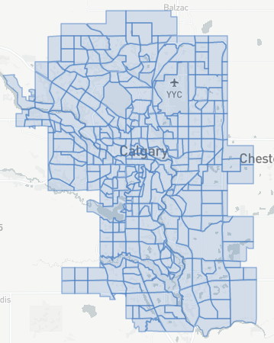
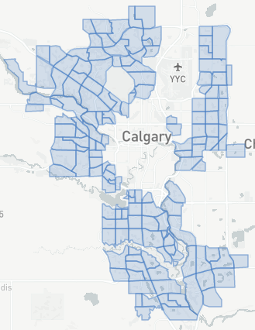
Data Acquisition and Cleaning
Community boundary data was acquired for mapping purposes from the City of Calgary’s open data portal. Only residential communities and those outside of the downtown core were to be considered, as industrial areas/business parks are already saturated with food service vehicles and as well because the client is actively looking to capitalize on the shift in demand away from the city centre and into residential areas. Thus, the geojson file containing boundary data for mapping was edited. The changes are represented by the images on the right.

Slide 6
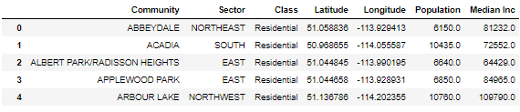
Data Acquisition and Cleaning
A feature set was then initiated for each community by extracting a list of communities from the geojson file and transforming it to a dataframe. This dataframe was then appended with Income and Population data from Calgary’s Community Profiles and Latitude and Longitude positions for each community were determined and appended to the dataframe by way of geocoding. This resulted in the incomplete Community Profile set seen below.

Slide 7
Data Acquisition and Cleaning
To complete the community profile dataset and as well to initiate creation of a second necessary dataset the Foursquare places API was utilized to obtain venue information for each of the communities under consideration. An call is made to the Foursquare API which filtered on the following categories.
Coffee shop
Café
Through consultation with the customer it was determined that establishments in food courts and those for which finished coffee products were not the primary product/service provided would not be meaningful competitors, so only the above categories were included. A search radius of 5km was applied in order to ensure that no venues were missed. A loop iterated over each community, passing their coordinates as parameters in the API call URL and all relevant venues were returned.

Slide 8
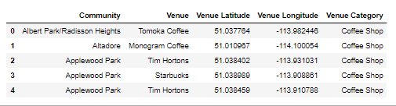
Data Acquisition and Cleaning
The results of the API call were then cleaned and processed to remove instances where unspecified categories were returned despite category filtering and as well to remove the many duplicates that resulted from overlapping search radii produced for the over 150 community coordinates passed by the loop.
Due to these overlapping search radii, the community labels returned were often inaccurate, so reverse geocoding was utilized to assign accurate community labels to each of the venues returned. The incomplete venues dataset took the form seen below.

Slide 9
Data Acquisition and Cleaning
The community labels in both the venue set and profile set needed to be harmonized with those in the geojson file for ease of merging data and for mapping, so a function was devised to test for consistency across dataframes and a filter dataframe was created from the original unaltered geojson file. This was necessary for filtering out the city non-residential and downtown communities from the venue set.
The venue set was then tested, filtered and processed. Inconsistent labels were adjusted and unwanted communities were removed. A subset of the venue set was then produced and grouped according to community so that a venue count per community could be produced and appended to the community profile set. The completed Community profile set can be seen on the following slide along with the completed venues set.

Slide 10
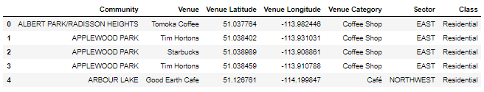
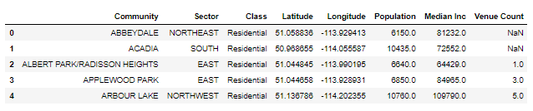
Data Acquisition and Cleaning
Full Venue Dataset
Full Community Profile Dataset

Slide 11
Methodology/Analysis
Given the nature of the business, it was determined that a focus on representing the data and the analytical results visually would be preferable.
The analysis is accomplished in 3 parts
Heat Mapping: A heat map is generated using the venues set. The goal is to provide a visual resource to be used for distinguishing between dense pockets of competing establishments and areas of the communities that might be conversely underserviced.
Choropleth Mapping: Choropleth maps are used to visually profile the individual communities by mapping profile data along a continuous color gradient determined by the magnitude of the measure being mapped. 4 choropleth maps are generated.
a. Population Choropleth
b. Income Choropleth
c. Market Saturation Choropleth
d. Community Market Potential Index Score Choropleth
3. K-Means Clustering: The K-Means algorithm is used to cluster/segment each community according to it’s income and market saturation profiles.

Slide 12
Methodology/Analysis
Heat Mapping
No Data subset is necessary for the heat map portion of the analysis. The goal is to identify dense pockets of competition for the client so that they can avoid these areas and stick to underserviced communities/areas.
For this purpose the ungrouped venue set is utilized and the coordinates for each of the venues returned by the Foursquare Places API call are mapped. Markers are included for each community for the viewers reference, and the population of each community is included in the marker label so that the viewer can get an idea of just how potentially underserviced (or otherwise) an particular area is.

Slide 13
Methodology/Analysis
2. Choropleth Mapping
This portion is handled using the community profile set. Choropleth maps for the income (Median Inc) and population (Population) features is straight forward as these nominal measures and their corresponding data are mapped on a continuous color gradient according to their magnitude and contained to their respective community boundaries.
The Market Saturation choropleth map involved creating a data subset including a feature titled ‘Saturation’. ‘Saturation’ is the result of calculating the population or residents per venue by simply dividing ‘Population’ by ‘Venue Count’ for each community. Null or zero values for ‘Venue Count’ can’t act as a numerator but are still meaningful, so null values for ‘Saturation’ receive a unique color assignment ‘Magenta’. To make sure the 13 cases for which no population data could be acquired didn’t also receive this unique color assignment null population values in the subset were replaced with the mean for the ‘Population’ feature.
In Community Market Potential Index Score also required creating a subset. A ‘Saturation’ feature is again created, however, the 13 communities lacking income and population data remain null this time and the null values for ‘Venue Count’ are instead replaced with 1. The data is normalized using Z-Score normalization and a weighted product of “Median Inc’ and ‘Saturation’ with weights of 60% and 40% applied respectively. The resulting Community Market Potential Index Score is then visualized on a choropleth map (see the full Report here for assumptions and reasoning)

Slide 14
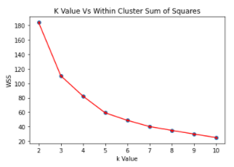
Methodology/Analysis
3. Community Clustering/Segmentation
A subset of the community set is created using the same process and criteria as the index score choropleth subset. The saturation measure is used in order to contract the feature set down to 2 features so that the clustering results are easier to visualize and analyze.
The normalized data is then passed through a loop iterating over a range of potential K-values and fitting a model for each potential K-value. The Elbow Method is then used to determine the optimal K-value for the data.
The Within-Cluster Sum of Squares is obtained and plotted on a scatterplot. The ‘Elbow’ for the curve is identified at K = 5, and so the optimal K-value for the data and the model is determined to be 5.
The model is then fit using the determined optimal K-Value, each feature pair is assigned a cluster label, the results are visualized and cluster labels assigned descriptive labels, and each community is assigned it’s respective cluster label.

Slide 15
Results
The goal of the analysis is to provide the client with simple and intuitive visual tools that leverage data for the purpose of aiding in the prioritization of communities in the early stages of their entrepreneurial Java Truck venture. Thus the results explored here are the resulting visual tools of the analysis which primarily take the form of various types of maps of the City of Calgary.

Slide 16
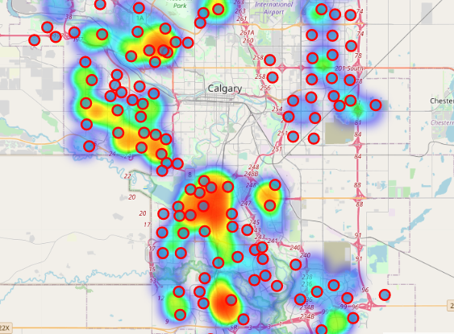
Results
Heat Mapping
All of the maps are best viewed in the notebook for this project which can be found here. Copy the link for the Notebook into the Notebook viewer here to view the maps.
The heat map shows the client where dense pockets of competition are located, and as well it shows where potentially underserviced communities can be located. Sever in the NE of the city can be seen to have no venues in or relatively nearby when compared to most, and it can also be seen that by sticking to the periphery the client may be able to address underserviced communities and regions where sudden pockets of demand have developed but have yet to be addressed by conventional brick-and-mortar establishments.

Slide 17
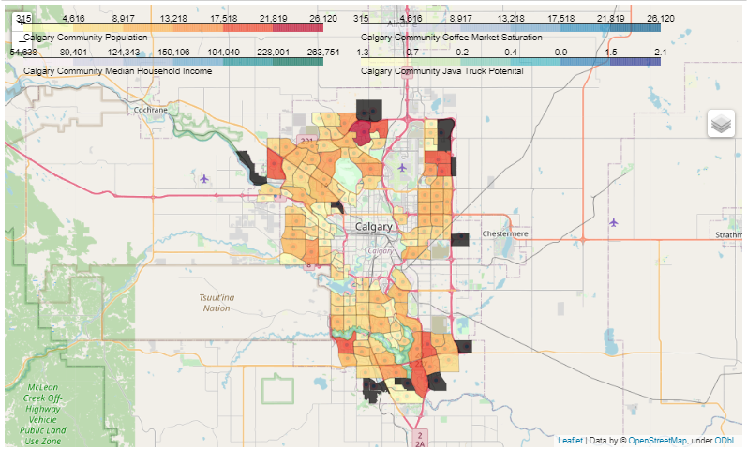
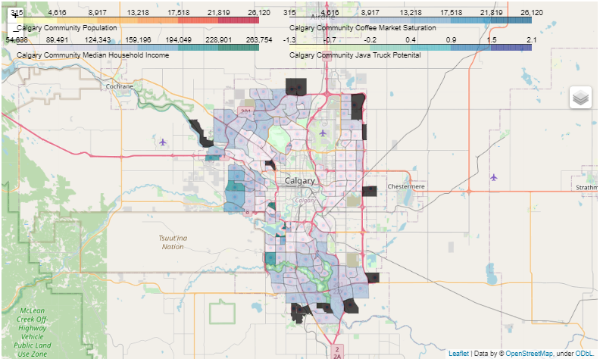
Results
2. Choropleth Maps
Community Population Choropleth
Community Median Household Income Choropleth

Slide 18
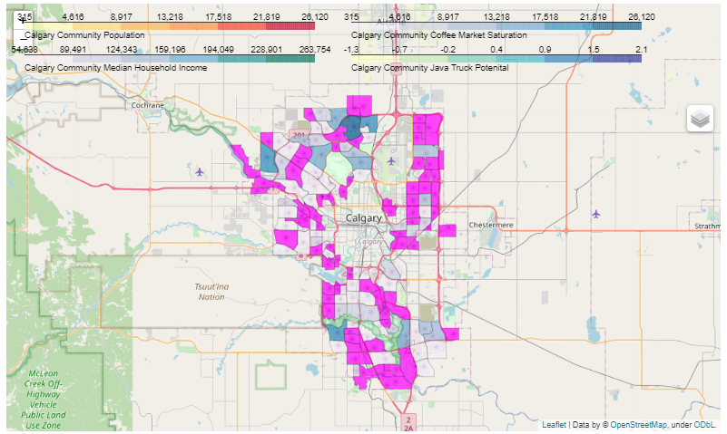
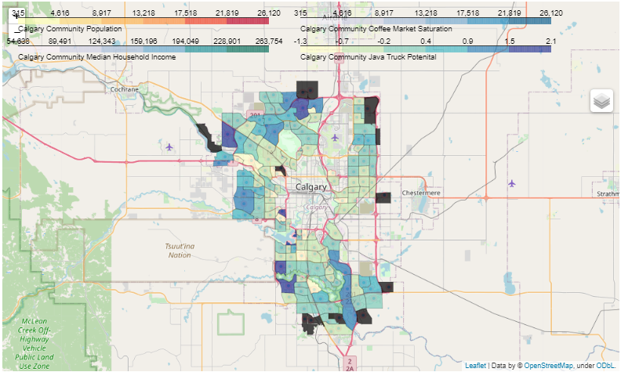
Results
2. Choropleth Maps
Market Saturation Choropleth
Community Market Potential Index Score Choropleth

Slide 19
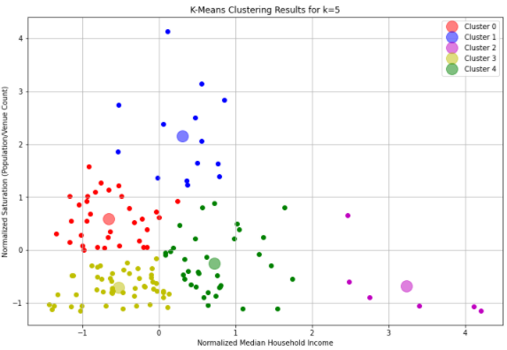
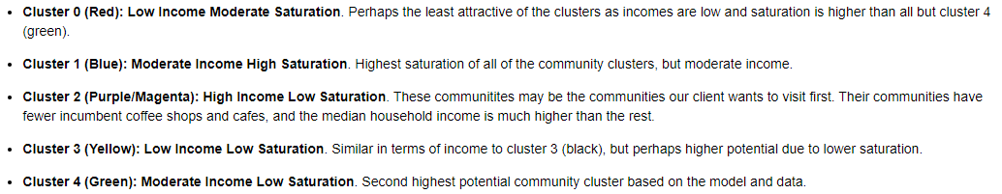
Results
3. K-Means Clustering/Community Segmentation
The cluster results are visualized in the scatter plot to the right. Each cluster label corresponds with a specific color as denoted by the provided legend, and each label and their respective color are given a descriptive label based on their respective income and saturation profiles.

Slide 20
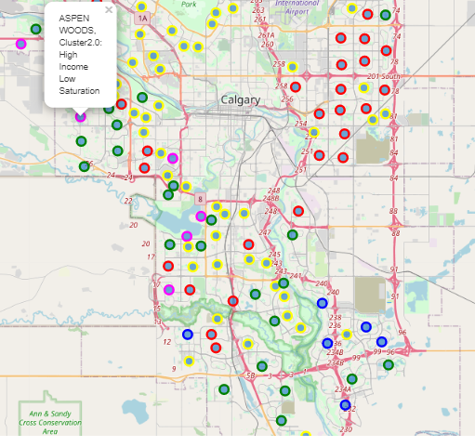
Results
Clustering Continued…
The clustering results are then
Appended to the primary community dataset
and each community is mapped and identified
with a marker corresponding to it’s color and
respective cluster assignment. A descriptive
label is provided and made visible by clicking on a given community.

